Slide 1
Welcome to all
for the MHRM Online lecture
By
Dr. Dhiraj Ovhal
HOD of Commerce

Slide 3
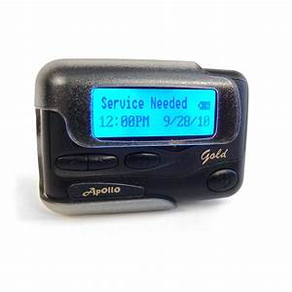
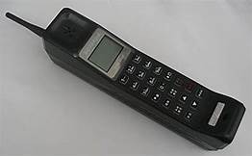
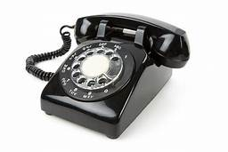
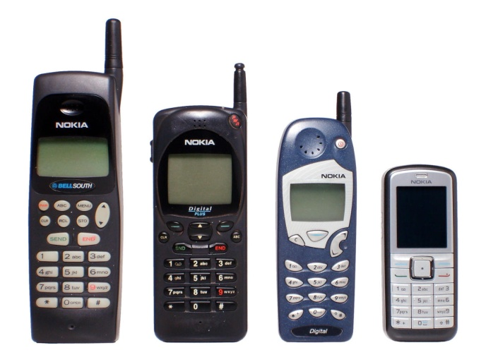

Slide 4
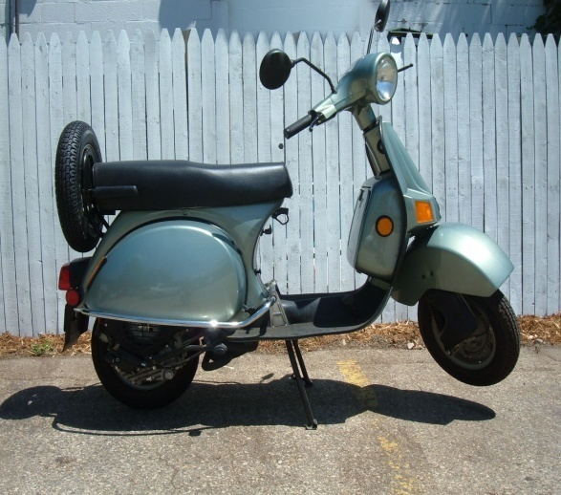
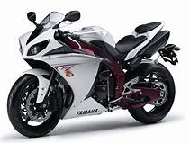
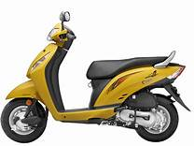

Slide 5
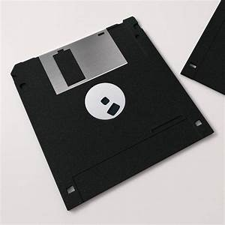

Slide 6
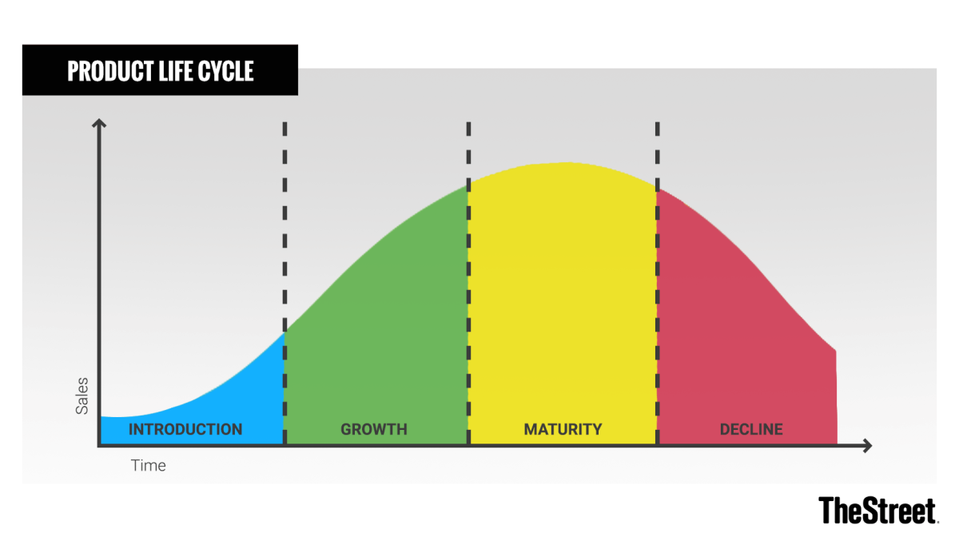
Q.2 Product life Cycle
Meaning:- Product life Cycle means during the life span of the product , it would passes different phrase/Stages such as Introduction stage, Growth stage, Maturity stage, and 4. Decline stage .

Slide 7
Introduction Stage:- :-
Maximum advt. to mass publicity as well as face competition and penetration pricing strategy ( Low price- to attract customers )

Slide 8
2. Growth Stage:- :-
Products survive and settled in the market. Increase profit and sales also. follow Skimming pricing strategy ( High price strategy)

Slide 9
3. Maturity Stage:- :-
Products sales are remained more or less stagnant. No new or additional customers. Only Reminder advertising done.

Slide 10
4. Decline Stage:- :-
New products/technology products available, no one like to purchase our products. Seller has two options i.e. Withdraw the products from market or modify and convert old products into new technology or like of customers.

Slide 11
Q.2 Product life Cycle
1.Introduction stage,
2.Growth stage,
3.Maturity stage,
4. Decline stage .

Slide 12
Thank You

Slide 13
Attendance Link
https://forms.gle/Xqvykv5vfEi1zpyF7
(Mention date at last point)

